Slide 1



Summer School in Quantitative Fisheries Stock Assessment
Day 1: Stock assessment methods in the Mediterranean and Black Sea: an overview
Alessandro Ligas
ligas@cibm.it

Slide 2
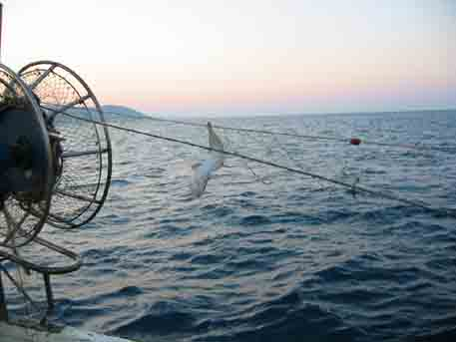
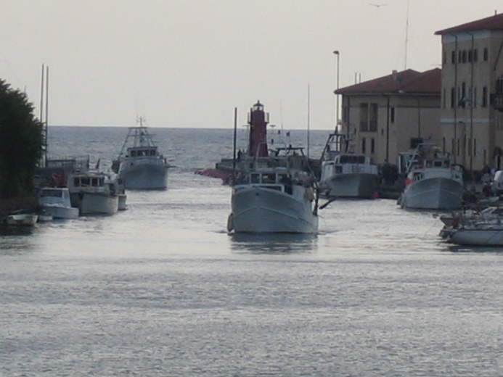
Stock assessment involves both biological interpretation and the use of various statistical-mathematical methods to make quantitative estimations and predictions about the state of a fish/shellfish population (or stock) (i.e. size, composition, regeneration rate, exploitation level, fishing pattern, etc.) (Hilborn and Walters 1992).
The ultimate aim of stock assessment is to provide biological reference points to be used as guidelines for the rational management of the fishery (e.g. sustainable harvest levels, such as maximum sustainable yield [MSY], sustainable exploitation rates [fishing mortality], etc.).

Slide 3
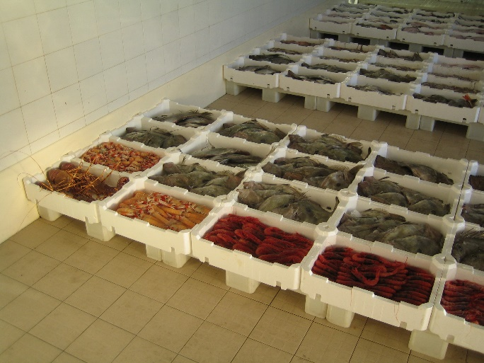

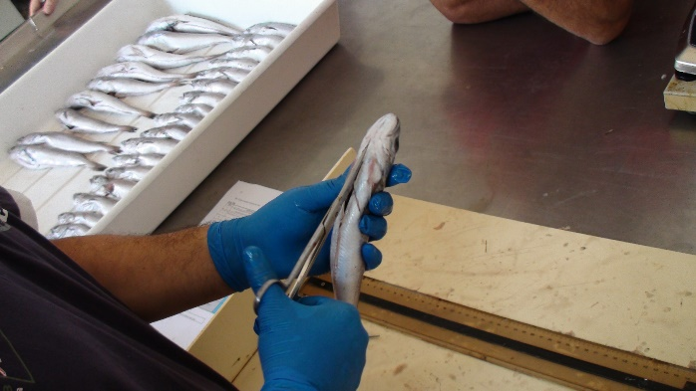
Interpretation of data used in stock assessment requires the knowledge of population (e.g. growth, natural mortality, and recruitment), fishing (e.g. selectivity), and sampling processes.
Unfortunately, there is a lack of understanding of these processes for most, if not all, stocks and even for those processes that have traditionally been assumed to be well understood (e.g. growth and selectivity).
If understanding is the path to be taken, then investment is needed in training stock assessment scientists, biological studies, and data collection in a coordinated and focused approach (Maunder and Piner, 2015).

Slide 4
Over the last century, stock assessment methods have progressed from descriptive models, often assuming equilibrium, to elaborate statistical models with many estimated parameters and formal approaches to evaluate uncertainty (Cadrin and Dickey-Collas, 2015). These methods can be classified in nine model categories according to the amounts or types of data and knowledge used in the model (ICES, 2012; STECF, 2016).
1. catch-only models;
2. time-series models;
3. biomass dynamics models;
4. delay-difference models;
5. Survey-based model (SURBA)
6. Length-based model estimator of Z: SEINE;
7. VPA-based models (Virtual Population Analysis);
8. Statistical catch-at-age (SCAA) models;
9. integrated analysis (IA) models.

Slide 5
The choice of the assessment model to be used is always a trade-off
That classification can be useful for organizing information about available approaches and providing guidance on model selection.
The choice is driven by several factors including the availability of appropriate data, the resources and expertise available and the type of advice required. In general, more sophisticated assessment models can provide more detailed advice and allow forecasts for fisheries management to be performed. However, these assessments also require additional data inputs and can be complex, time-consuming, and costly (Hilborn, 2003).
It is important to identify the data sources and assumptions that are pertinent for each stock, and to select the most appropriate method which best uses all the available information and resources (ICES, 2015).

Slide 6
1. Catch-only models
These models do not assume any population dynamics and they are simple methods for estimating sustainable catch levels when the only data available are little more than a time series of catches. An example is the Depletion Corrected Average Catch (DCAC; MacCall, 2007). These models provide advice on whether the recent average catch is sustainable or not but without information on stock status and/or trend.
Several new catch only models have appeared in recent years. For example, Rosenberg et al. (2013) tested 4 of these models and their performance in retrieving B/B_{MSY} ratio. Martell and Froese (2013) have produced an approach based on surplus production (Catch MSY). This method requires more than 10 years of catch data.
In many cases, long time-series of data are not available, thus some length-based methods may be more applicable.

Slide 7
2. Time series models
As in the catch only model the assumptions on the population dynamics are minimal. Typical data are catch or abundance index (from surveys) time series.
As in the catch-only models, also in the time-series models the assumptions on population dynamics are minimal. Typical data are time series of catches or abundance indices.
An example is the Index Method (AIM) which fits a relationship between time series of relative stock abundance indices obtained from the surveys and historical landings data. The AIM calculates two derived quantities: Replacement Ratio and Relative Fishing mortality. Management advice can be qualitative, such as the trend in time, and/or whether the stock is approaching a possible trigger for management action (e.g. the lowest point in the time series).

Slide 8
3. Biomass dynamics models
Biomass dynamics models (or Surplus production models) are among the simplest stock assessment models, and can characterize the dynamics of a stock in terms of changes in biomass.
Minimal data request: catch/effort data and one (or more) abundance index (from surveys), thus not needing any biological data (individual growth, size or age structure, maturity, natural mortality).
However, they cannot provide explanations for changes in abundance, as changes in stock biomass, recruitment, and mortality are all examined collectively.
The models assume aggregated biomass dynamics controlled by a low number of parameters: K (carrying capacity), r (intrinsic growth rate), initial biomass and a catchability coefficient related to F.
With sufficient contrast in the time series (i.e. observations above and below B_{MSY}, periods with increasing abundance index), these models can provide estimates of MSY (B/B_{MSY} and F/F_{MSY} ratios) and estimate the catch corresponding to F_{MSY} (ICES, 2012).

Slide 9
3. Biomass dynamics models (continue)
An example of biomass dynamics models can be ASPIC (Prager, 1994) which fits non-equilibrium versions of Schaefer, Fox and the generalized version of Pella and Tomlinson model (1969).
A more recent implementation of biomass dynamics models is the state-space surplus production model with Schaefer production function developed by J. Thorson (https://github.com/James-Thorson/state_space_production_model).
SPICT (https://github.com/mawp/spict), also implemented in Template Model Builder (TMP), is an R package for fitting surplus production models in continuous-time-to-fisheries-catch-data and biomass indices (either scientific or commercial). Main advantages of SPICT are:
1. Reference points (MSY, F_{MSY}, B_{MSY}) are estimated with uncertainties.
2. Short-term forecasts and management strategy evaluation (MSE) can be implemented.
3. Fully stochastic model: observation error is included in catch and index observations, and process error is included in fishing and stock dynamics.
4. The model is formulated in continuous-time, thus can incorporate arbitrarily sampled data.

Slide 10
4. Delay-difference models
An example is Collie-Sissenwine Analysis (Catch Survey Analysis) model (Collin-Sissenwine, 1983). This model is a stage-based model that estimates the abundance of two classes, defined as recruits and post-recruits and often some somatic growth relationship and natural mortality are included in the population dynamics. The model requires indices of abundance for these two stages and provides estimates of both abundance and mortality rates.
Main limitations are generally similar to biomass dynamics models, although they have more biological realism than the biomass dynamics models by partitioning recruitment and adult somatic growth.

Slide 11
5. Survey-based model (SURBA)
The basis of SURBA is a simple survey-based separable model of mortality. The separable model used in SURBA assumes that total mortality Z_{a,y} for age a and year y can expressed as:
Z_{a,y} = s_{a} x f_{y}
where s_{a} and f_{y} are the age and year effects of mortality, respectively.
Parameters are estimated by minimizing the weighted sum-of-squares of observed and estimated abundance indices.
Abundance estimates are generated by SURBA on a relative scale only, and plotted as mean-standardized values for ease of comparison.
SURBA can only provide advice on relative trends in abundance and total mortality, and is very sensitive to assumptions about catchability (estimates of Z can vary under different assumptions about catchability) (Cotter et al, 2007).

Slide 12
6. Length-based model estimator of Z: SEINE
The Beverton-Holt mortality estimator has been frequently used in data-limited situations, as requires only the von Bertalanffy growth formula (VBGF) parameters (k and L∞), the smallest size at which animals are fully vulnerable to the fishery (L’), and the mean length of the animals larger than L’. This model assumes equilibrium conditions.
The SEINE model is based on the work by Gedamke and Hoening (2006), who developed a procedure to estimate a series of mortality rates from mean length data representing non-equilibrium conditions in multiple years. It estimates the levels of total mortality based on observed length-frequency data and VBGF parameters. The user may estimate either single or multiple changes in mortality levels.

Slide 13
7. VPA-based approaches
Virtual population analysis (VPA) can work with catch-at-age data (assumed as known and without error) to estimate historical population size and fishing mortality (F).
As a rule of thumb the time series of catch-at-age data should cover at least the entire life history of a cohort.
VPA is performed separately for each cohort (year class) within the exploited portion of the population, working backward in time from the latest year and oldest age in each cohort (terminal age) to the youngest age for which it is possible to estimate the numbers of fish if catch-at-age and natural mortality (M) are known. If some cohort does not reach its maximum age in the last year of the time series, the mortality of younger fish in the final year cannot be estimated, with the risk of knowing the least about cohorts contributing to future biomass, which is often the most desirable information from a management perspective.

Slide 14
7. VPA-based approaches (continue)
However, abundance indices (typically termed tuning), such as scientific surveys, CPUE, or tagging data, can be used to estimate the abundance of the incomplete cohorts and F in the most recent years.
Furthermore, in the case a spawning-recruitment function is fitted to model outputs, complete advice on stock state and forecasts of limit and target catch levels can be provided, as well as estimates of reference points.
The most widely used VPA-based model in the GFCM and STECF working groups is the Extended Survivor Analysis (XSA; Darby and Flatman, 1994; Shepherd, 1999).
Other VPA-based models are: ADAPT, separable VPA, Length-Cohort Analysis (LCA; i.e. VIT software), etc.

Slide 15
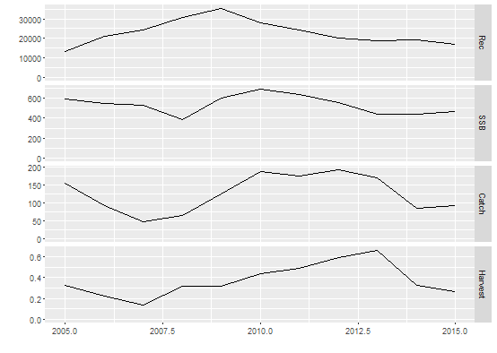
7. VPA-based approaches (continue)
Typical main outputs plot of an XSA assessment (blue and red shrimp, Aristeus antennatus, in GSA9; GFCM WGSAD 2016).

Slide 16
8. Statistical catch-at-age (SCAA) models
Statistical catch-at-age (SCAA) models use catch-at-age data to derive estimates of historical population size and fishing mortality (F). Unlike VPA, model parameters are estimated working forward in time, and the analyses do not require the assumption that removals from the stock/fishery are known without error.
State-space stock assessment model (SAM; Köster et al., 2011), a4a (Jardim et al., 2014), (also many custom ADMB codes) are examples of SCAA models. In general, complete advice on stock status and forecasts of limit and target catch levels are attainable as well as estimates of reference points.
SCAA models can also provide estimates of uncertainty in the estimated model parameters.

Slide 17
8. Statistical catch-at-age (SCAA) models (continue)
Typical main outputs plot of a SAM assessment (Atlantic cod, Gadus morhua, in ICES division VIIa; ICES WGSE 2014).

Slide 18
9. Integrated analysis (IA) models
Integrated analysis (IA) are complex models that estimate internally a wide range of biological and fisheries parameters, as well as stock abundance and fishing mortality.
In SCAA, these parameters are estimated prior to the assessment, thus more explicitly.
IA also can provide complete advice on stock status and forecasts of limit and target catch levels, as well as estimates of reference points.
An example of an IA model is Stock-Synthesis (SS3; Methot and Wetzel, 2013) which is also capable of including spatial and size-based dynamics, as well as age-based dynamics and can operate on a range of time steps, such as seasonal.
Another example is CASAL (Sullivan et al., 1990)
IA are typically labour intensive to set up and “data hungry”; they have to estimate a large number of parameters (particularly when spatial and size-based dynamics are considered) and can take a long time to fit. They also need high level expertise.

Slide 19
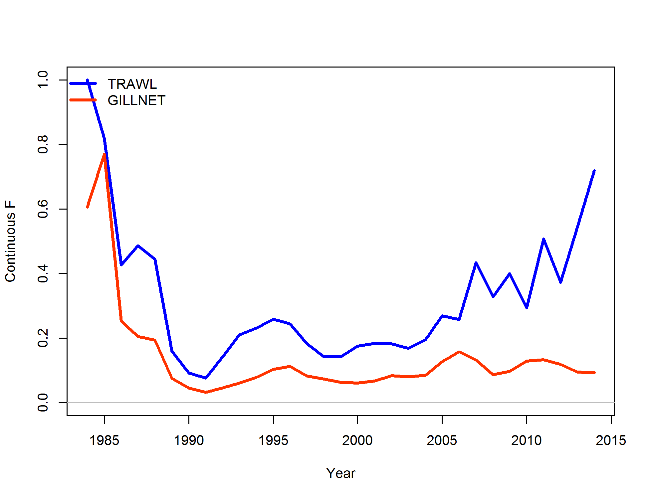
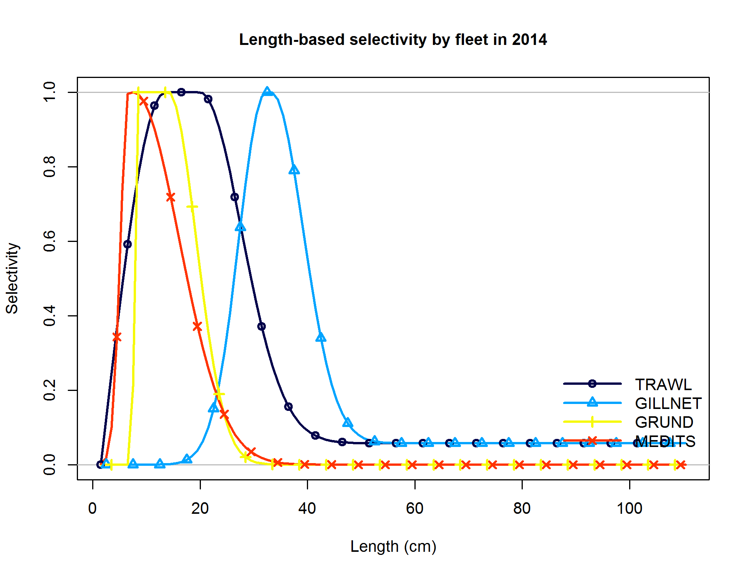
9. Integrated analysis (IA) models (continue)
Some outputs from an SS3 assessment (European hake in GSA9).
Fishing mortality (F) by fishery (Trawling and Gill net)
Selectivity by gear (Trawling and Gill net) and tuning fleet (Medits and Grund)

Slide 20
Stock assessments in the Mediterranean and Black Sea
Quantitative-analytical assessment of stocks in the Mediterranean basin started about 20 years later compared to northern Europe, USA, Australia, etc. due to the lack of systematic data collection protocols that hindered the assessment of fisheries resources in the Mediterranean until the 2000s (Rätz et al., 2013).
Since then, the number of consistently assessed stocks has increased as a result of both the enhanced data collection system, and the effort of the main stakeholders involved in the assessment and management of fisheries (i.e., EU and GFCM) (Sartor et al., 2014; FAO, 2016; STECF, 2016). Nonetheless, the number of stocks assessed is still limited compared to the total number of stock exploited in the Mediterranean and Black Seas: only around 40% of the landings in the Mediterranean and Black Seas come from stocks for which scientific advice is available, while an even smaller percentage of the landings come from fisheries that are subject to management plans (GFCM, 2016).

Slide 21
Stock assessments in the Mediterranean and Black Sea
Since 2012, a total of 357 stock assessments were performed under GFCM and STECF working groups accounting for 37 species and 144 stocks assessed in the Mediterranean and Black Sea.
In the case of demersal stocks, several methods have been used so far. In more than 50% of stocks assessed, Extended Survivor Analysis (XSA) has been used, while Length-Cohort Analysis (LCA) (i.e. VIT) was applied in more than 10% of the assessments carried out under the framework of GFCM and STECF working groups in the Mediterranean and Black Sea. Statistical catch-at-age models, such as a4a, and Integrated Assessments, such as SS3, are still used in few stocks.
As concerns small pelagics, non-equilibrium surplus production models (i.e. BioDyn) are generally used. However, several assessments are still based on empirical approach (trends from Acoustic surveys). SAM is used for anchovy and sardine in GSAs 17-18 (Adriatic Sea).

Slide 22
Red mullet stocks assessed since 2012 (Reference year 2011)
GSA | Species | Ref. Year | F_{curr} | F_{MSY} | F_{curr}/F_{MSY} | Method | WG
7 | Red mullet | 2011 | 1.26 | 0.51 | 2.47 | XSA | STECF
15_16 | Red mullet | 2011 | 1.3 | 0.45 | 2.89 | XSA | STECF
17 | Red mullet | 2011 | 0.71 | 0.36 | 1.97 | XSA | STECF
18 | Red mullet | 2011 | 1.5 | 0.5 | 3.00 | XSA | STECF
9 | Red mullet | 2011 | 0.68 | 0.61 | 1.11 | XSA, ADAPT | STECF
11 | Red mullet | 2011 | 0.97 | 0.29 | 3.34 | XSA | STECF
17 | Red mullet | 2011 | 0.82 | 0.36 | 2.28 | XSA | STECF
19 | Red mullet | 2011 | NA | 0.3 | NA | XSA | STECF
5 | Red mullet | 2012 | 0.93 | 0.14 | 6.64 | XSA | STECF
6 | Red mullet | 2012 | 1.69 | 0.45 | 3.76 | XSA | STECF
11 | Red mullet | 2012 | 1.07 | 0.11 | 9.73 | XSA | STECF
17 | Red mullet | 2012 | 0.55 | 0.21 | 2.62 | SS3 | STECF
6 | Red mullet | 2013 | 1.47 | 0.45 | 3.27 | XSA | STECF
7 | Red mullet | 2013 | 0.45 | 0.14 | 3.21 | XSA | STECF
9 | Red mullet | 2013 | 0.7 | 0.6 | 1.17 | XSA | STECF
25 | Red mullet | 2013 | NA | 0.3 | NA | XSA | STECF
17_18 | Red mullet | 2014 | 0.54 | 0.41 | 1.32 | XSA | STECF
19 | Red mullet | 2014 | 1 | 0.45 | 2.22 | XSA | STECF
7 | Red mullet | 2011 | NA | NA | NA | NA | GFCM
15_16 | Red mullet | 2011 | 1.3 | 0.45 | 2.89 | XSA | GFCM
17 | Red mullet | 2011 | 0.5 | 0.253 | 1.98 | XSA | GFCM
5 | Red mullet | 2012 | 0.93 | 0.15 | 6.20 | XSA | GFCM
6 | Red mullet | 2012 | 0.9 | 0.51 | 1.76 | XSA | GFCM
7 | Red mullet | 2012 | 0.56 | 0.14 | 4.00 | XSA | GFCM
10 | Red mullet | 2012 | 0.44 | 0.55 | 0.80 | XSA | GFCM
17 | Red mullet | 2012 | 1.06 | 0.2 | 5.30 | XSA | GFCM
19 | Red mullet | 2012 | 1.17 | 0.38 | 3.08 | XSA | GFCM
6 | Red mullet | 2013 | 0.69 | 0.51 | 1.35 | XSA | GFCM
7 | Red mullet | 2013 | 0.45 | 0.14 | 3.21 | XSA | GFCM
10 | Red mullet | 2013 | 0.5 | 0.5 | 1.00 | XSA | GFCM
25 | Red mullet | 2013 | 0.34 | 0.23 | 1.48 | XSA | GFCM
7 | Red mullet | 2014 | 0.34 | 0.14 | 2.43 | XSA | GFCM
18 | Red mullet | 2014 | 0.48 | 0.42 | 1.14 | XSA | GFCM
25 | Red mullet | 2014 | 0.54 | 0.22 | 2.45 | XSA | GFCM
5 | Red mullet | 2014 | 0.48 | 0.17 | 2.82 | XSA | GFCM
1_3_4 | Red mullet | 2014 | 0.43 | 0.26 | 1.65 | XSA | GFCM
17 | Red mullet | 2014 | 1.3 | 0.52 | 2.50 | XSA | GFCM

Slide 23
European hake stocks assessed since 2012 (Reference year 2011)
GSA | Species | Ref. Year | F_{curr} | F_{MSY} | F_{curr}/F_{MSY} | Method | WG
7 | Hake | 2011 | 1.43 | 0.24 | 6.0 | XSA | STECF
11 | Hake | 2011 | 2.6 | 0.19 | 13.7 | XSA | STECF
17 | Hake | 2011 | 2.02 | 0.2 | 10.1 | XSA | STECF
19 | Hake | 2011 | 1.09 | 0.12 | 9.1 | XSA | STECF
18 | Hake | 2011 | 0.92 | 0.21 | 4.4 | VIT | STECF
10 | Hake | 2012 | 1 | 0.14 | 7.1 | XSA | STECF
7 | Hake | 2012 | 1.83 | 0.11 | 16.6 | XSA | STECF
1 | Hake | 2012 | 1.61 | 0.22 | 7.3 | XSA | STECF
11 | Hake | 2012 | NA | NA | NA | XSA | STECF
19 | Hake | 2012 | 1.21 | 0.22 | 5.5 | XSA | STECF
18 | Hake | 2012 | 1 | 0.19 | 5.3 | XSA | STECF
6 | Hake | 2013 | 1.48 | 0.15 | 9.9 | XSA | STECF
7 | Hake | 2013 | 1.67 | 0.17 | 9.8 | a4a | STECF
9 | Hake | 2013 | 1.3 | 0.22 | 5.9 | XSA | STECF
17 | Hake | 2013 | 1.01 | 0.28 | 3.6 | XSA | STECF
1 | Hake | 2014 | 1.2 | 0.21 | 5.7 | XSA | STECF
5 | Hake | 2014 | 1.06 | 0.16 | 6.6 | XSA | STECF
6 | Hake | 2014 | 1.39 | 0.26 | 5.3 | XSA | STECF
7 | Hake | 2014 | 1.64 | 0.11 | 14.9 | XSA | STECF
9 | Hake | 2014 | 0.95 | 0.23 | 4.1 | XSA | STECF
10 | Hake | 2014 | 0.906 | 0.198 | 4.6 | XSA | STECF
11 | Hake | 2014 | 1.49 | 0.166 | 9.0 | XSA | STECF
17_18 | Hake | 2014 | 1.1 | 0.16 | 6.9 | XSA | STECF
19 | Hake | 2014 | 0.95 | 0.18 | 5.3 | XSA | STECF
5 | Hake | 2015 | 1.3 | 0.17 | 7.6 | XSA | GFCM
6 | Hake | 2015 | 1.6 | 0.2 | 8.0 | XSA | GFCM
7 | Hake | 2015 | 1.92 | 0.12 | 16.0 | XSA | GFCM
17_18 | Hake | 2015 | 0.48 | 0.21 | 2.3 | SS3 | GFCM
12-16 | Hake | 2013 | 0.63 | 0.14 | 4.5 | XSA | GFCM
12_16 | Hake | 2014 | 0.71 | 0.12 | 5.9 | XSA | GFCM
12_16 | Hake | 2015 | 0.83 | 0.12 | 6.9 | XSA | GFCM
9 | Hake | 2015 | 1.08 | 0.24 | 4.5 | SS3 | GFCM

Slide 24
References
- Cadrin S.X., Dickey-Collas M. 2015. Stock assessment methods for sustainable fisheries. ICES Journal of Marine Science, 72: 1–6.
- Chen Y., Kanaiwa M., Wilson C. 2005. Developing and evaluating a size‐structured stock assessment model for the American lobster, Homarus americanus, fishery. New Zealand Journal of Marine and Freshwater Research, 39(3):xx
- Collie J. S., Sissenwine M.P. 1983. Estimating population size from relative abundance data measured with error. Canadian Journal of Fisheries and Aquatic Sciences, 40: 1871–1879.
- Darby C.D ., Flatman S. 1994. Virtual Population Analysis: Version 3.1 (Windows/Dos) user guide. Info. Tech. Ser., MAFF Direct. Fish. Res., Lowestoft, (1): 85 pp.
- Deriso R. B. 1980. Harvesting strategies and parameter estimation for an age-structured model. Canadian Journal of Fisheries and Aquatic Sciences, 37: 268–282.
- Dick E.J., MacCall A.D. 2011. Depletion-Based Stock Reduction Analysis: A catch-based method for determining sustainable yields for data-poor fish stocks. Fisheries Research, 110: 331–341.
- FAO 2016. The State of Mediterranean and Black Sea Fisheries. General Fisheries Commission for the Mediterranean. Rome, Italy. 151 pp.
- GFCM, 2016b. Resolution GFCM/40/2016/2 for a mid-term strategy (2017–2020) towards the sustainability of Mediterranean and Black Sea fisheries. FAO-GFCM, Rome. 17 pp.
- Hilborn R. 2003. The state of the art in stock assessment: where we are and where we are going. Scientia Marina, 67(Suppl. 1): 15-20.
- Hilborn R., Walters C.J. 1992. Quantitative Fisheries Stock Assessment: Choice, Dynamics and Uncertainty. Chapman Hall, New York.
Köster F., Kainge P.I., Beyer J. 2011. Introducing state-space stock assessment (SAM), split species issues and spatial modelling. Paper presented at 3rd Benguela Current Commission Annual Science Forum, Swakopmund, South Africa.
- ICES 2012. Report on the Classification of Stock Assessment Methods developed by SISAM. ICES CM2012/ACOM/SCICOM: 01. 15 pp.
- ICES 2015. Report of the Fifth Workshop on the Development of Quantitative Assessment Methodologies based on Life-history Traits, Exploitation Characteristics and other Relevant Parameters for Data-limited Stocks (WKLIFE V), 5–9 October 2015, Lisbon, Portugal. ICES CM 2015/ACOM:56. 157 pp.

Slide 25
References
- Jardim E., Millar C.P., Mosqueira I., Scott F., Osio G.C., Ferretti M., Alzorriz N., Orio A. 2014. What if stock assessment is as simple as a linear model? The a4a initiative. ICES Journal of Marine Science, doi: 10.1093/icesjms/fsu050.
- Maunder M.N., Piner K.R. 2015. Contemporary fisheries stock assessment: many issues still remain. ICES Journal of Marine Science, 72: 7–18.
- MacCall A. D. 2009. Depletion-corrected average catch: a simple formula for estimating sustainable yields in data-poor situations. ICES Journal of Marine Science, 66: 2267–2271.
- Methot Jr. R.D., Wetzel C.R. 2013. Stock synthesis: A biological and statistical framework for fish stock assessment and fishery management. Fisheries Research, 142: 86-99.
- Prager M. H. 1994. A suite of extensions to a non-equilibrium surplus-production model. Fishery Bulletin, 92: 374–389.
- Rätz H.J., Charef A., Abella A., Colloca F., Ligas A., Mannini A., Lloret J. 2013. A medium-term, stochastic forecast model to support sustainable, mixed fisheries management in the Mediterranean Sea. Journal of Fish Biology, 83: 921-938.
- Sartor P., Colloca F., Maravelias C., Maynou F. 2014. Critical assessment of the current understanding/knowledge of the framework of the Ecosystem Approach to Fisheries in the Mediterranean and Black Seas. Scientia Marina, 78(S1): 19-27.
- Shepherd J. G. 1999. Extended survivors analysis: An improved method for the analysis of catch-at-age data and abundance indices. ICES Journal of Marine Science, 56: 584-591
- STECF 2016. Methodology for the stock assessments in the Mediterranean Sea (STECF-16-14). Publications Office of the European Union, Luxembourg, 166 pp.
- Sullivan P.J., Lai H.L., Gallucci, V.F. 1990. A catch-at-length analysis that incorporates a stochastic model of growth. Canadian Journal of Fisheries and Aquatic Sciences, 47: 184–198.
- Walters C. J., Martell S.J.D., Korman J. 2006. A stochastic approach to stock reduction analysis. Canadian Journal of Fisheries and Aquatic Sciences, 63: 212–223.

